Slide 1

Please install the required softwares before class
Zou Yi
2021-9-22 18:30~7:15

Slide 2
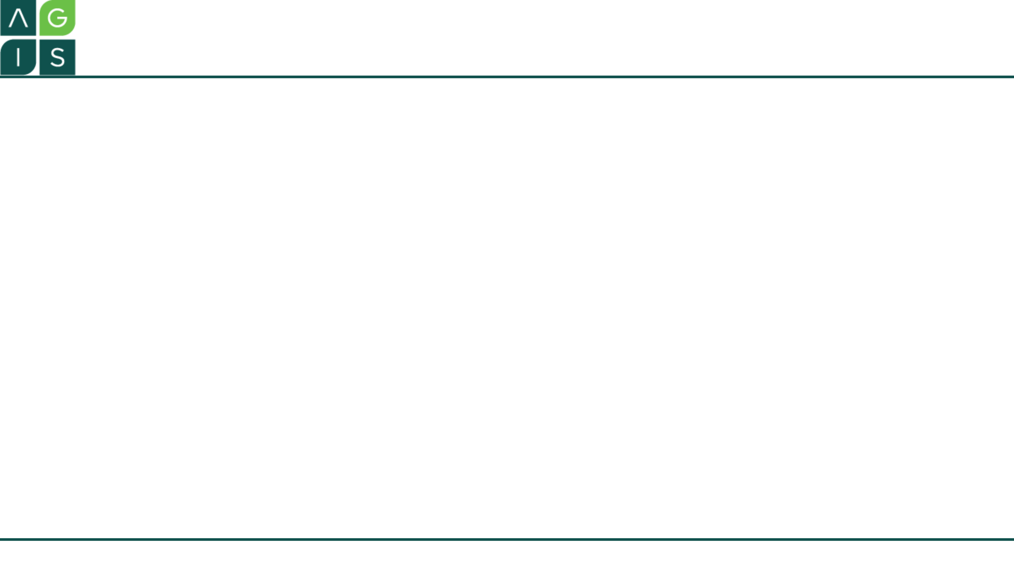
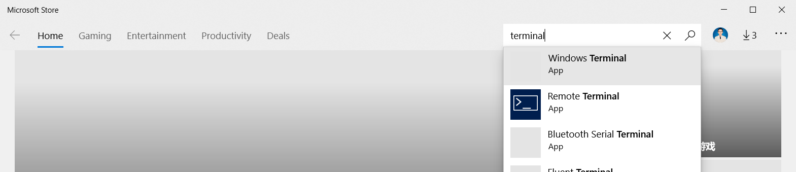
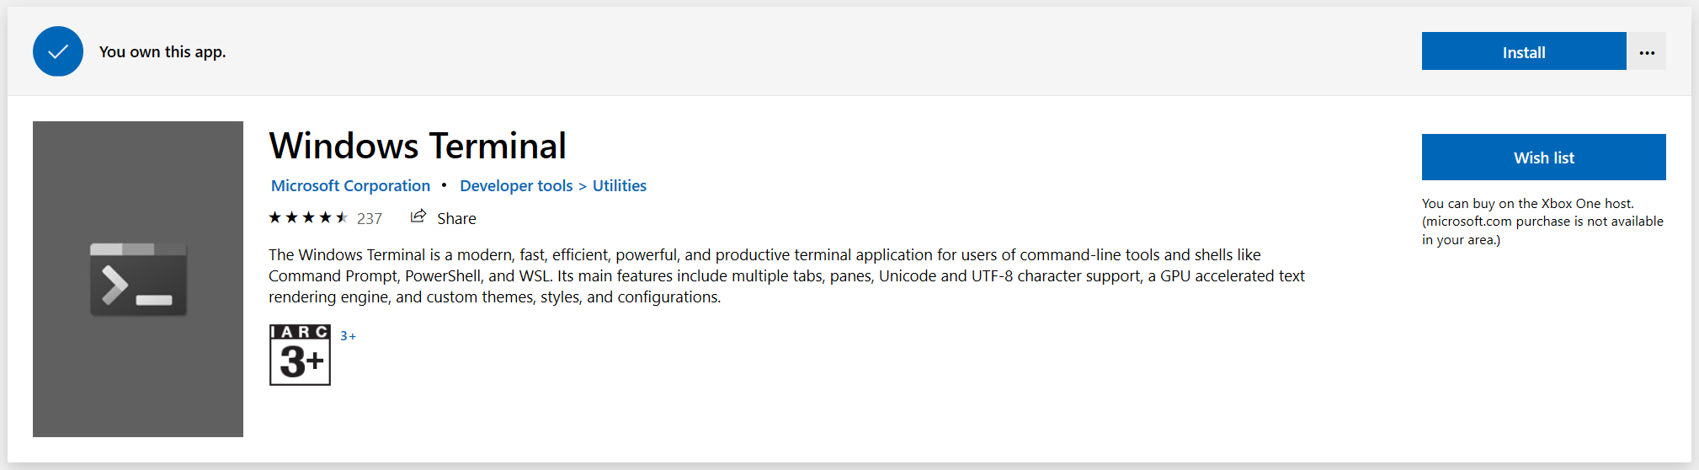
Install Windows Terminal
https://github.com/microsoft/terminal

Slide 3
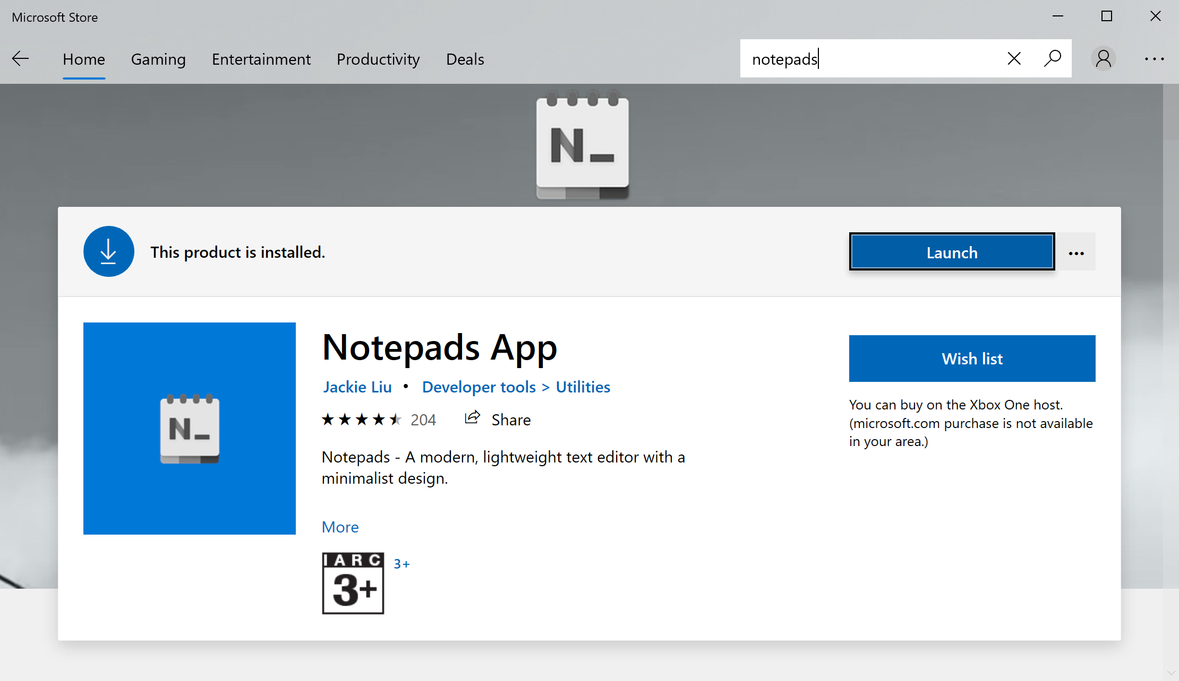
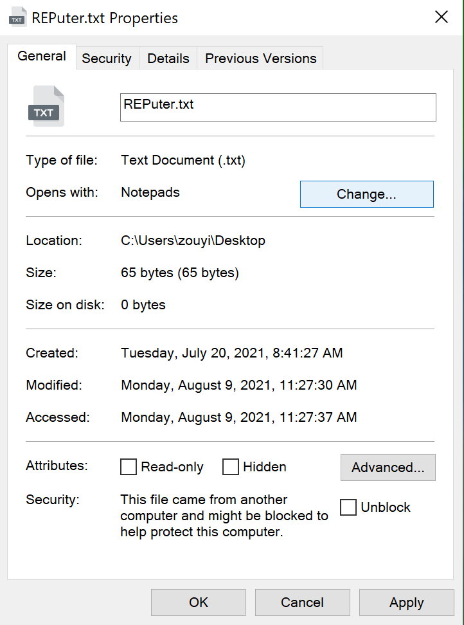
Install Notepads

Slide 4
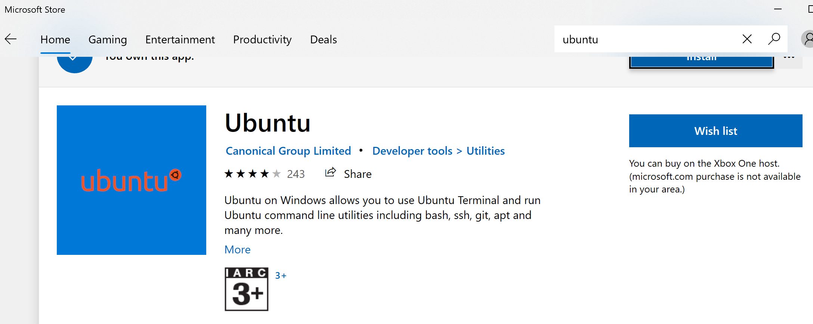
Windows Subsystem for Linux (WSL2)
WSL2 provides a fast, lightweight way to run Linux programs on Windows.
https://docs.microsoft.com/en-us/windows/wsl/install-win10
Step 1: Install WSL2
1) search for Turn Windows Features on or off
2) enable two features, the Virtual Machine Platform and the Windows Subsystem for Linux
3) reboot the computer
4) open Windows Terminal as an administrator
5) run the command: wsl --set-default-version 2
Step 2: Install Ubuntu
username: zouyi
password: zouyi
Step 3: updating the WSL2 Linux kernel
https://wslstorestorage.blob.core.windows.net/wslblob/wsl_update_x64.msi
Bidirectional access in Windows and Ubuntu
$ cd /mnt/c
$ explorer.exe .

Slide 5
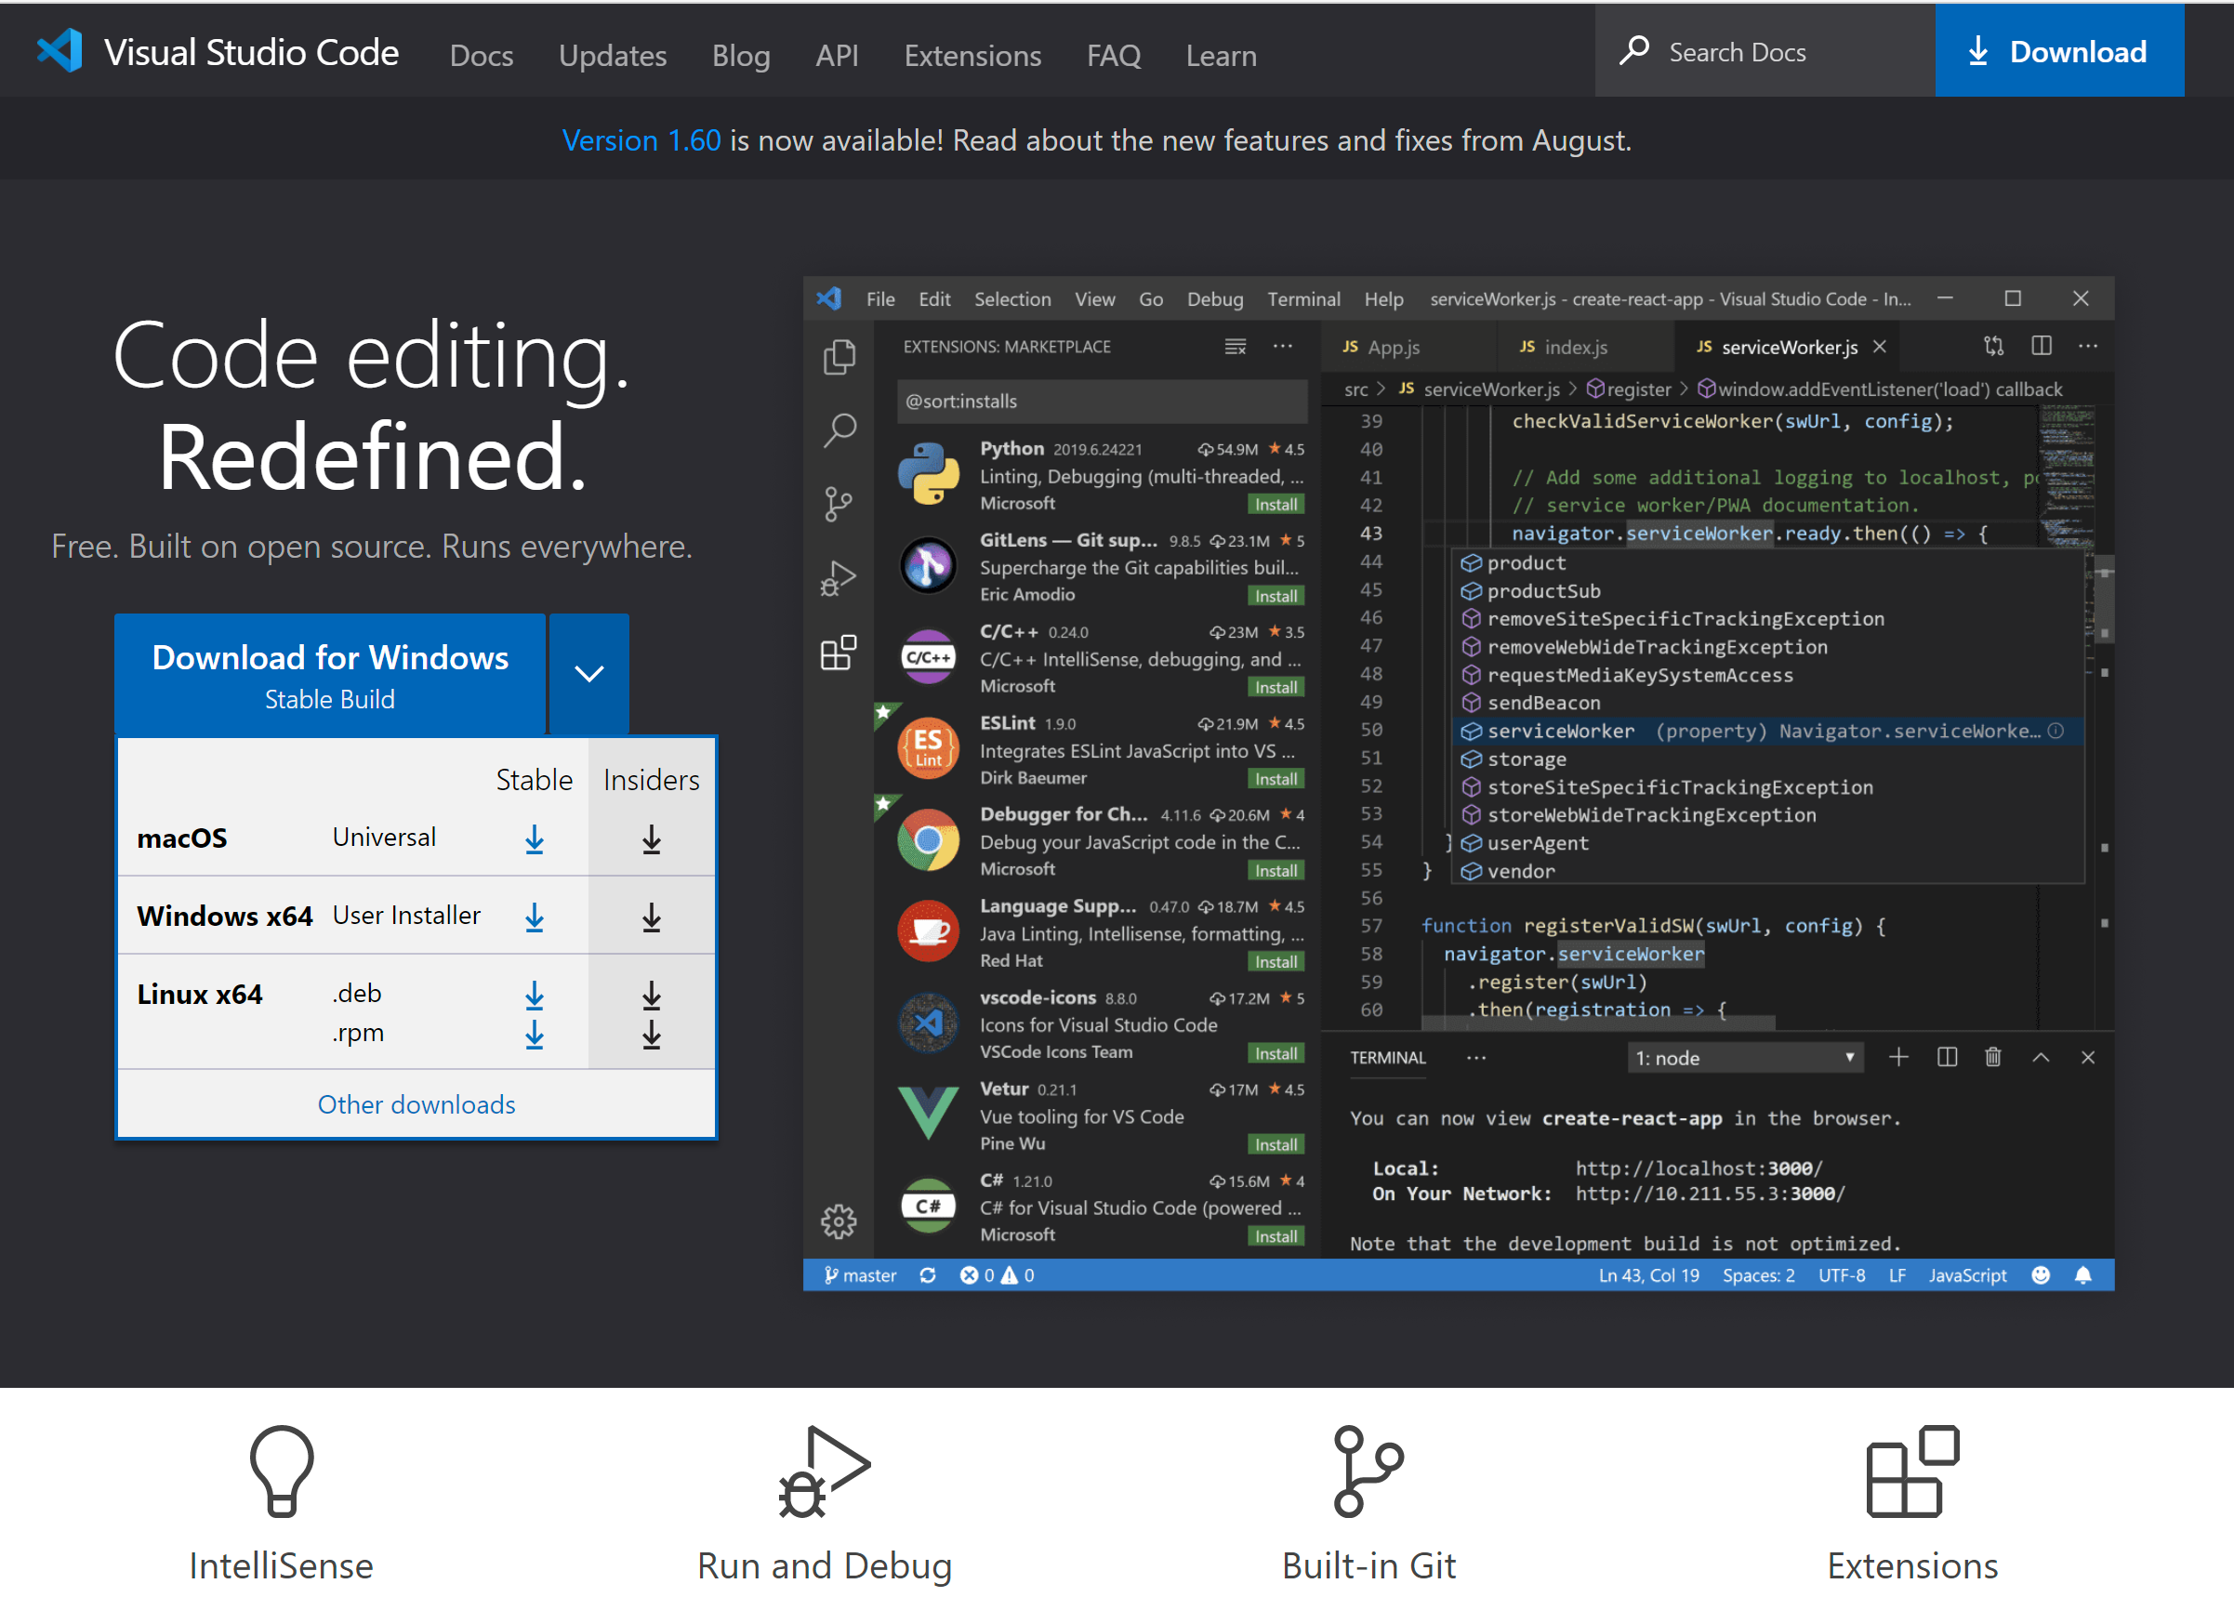
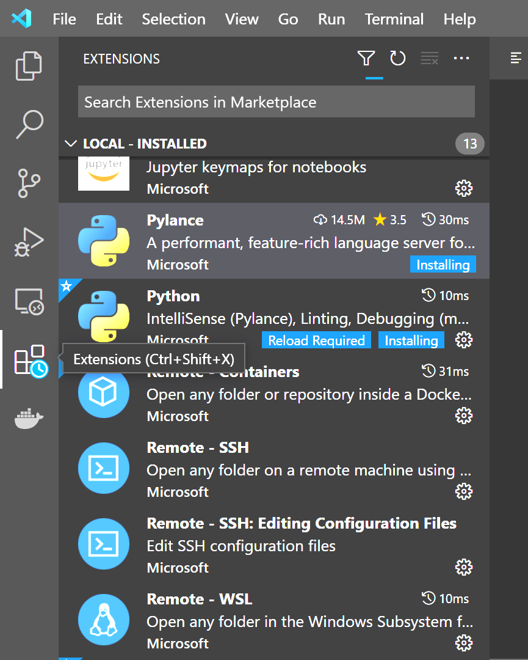
Install Visual Studio Code
Visual Studio Code is a free, cross-platform, open source code editor from Microsoft.
https://code.visualstudio.com/
Install the following extensions:
Pylance
Python
Remote-SSH
Remote-SSH: Editing Configuration Files
vscode-pdf

Slide 6
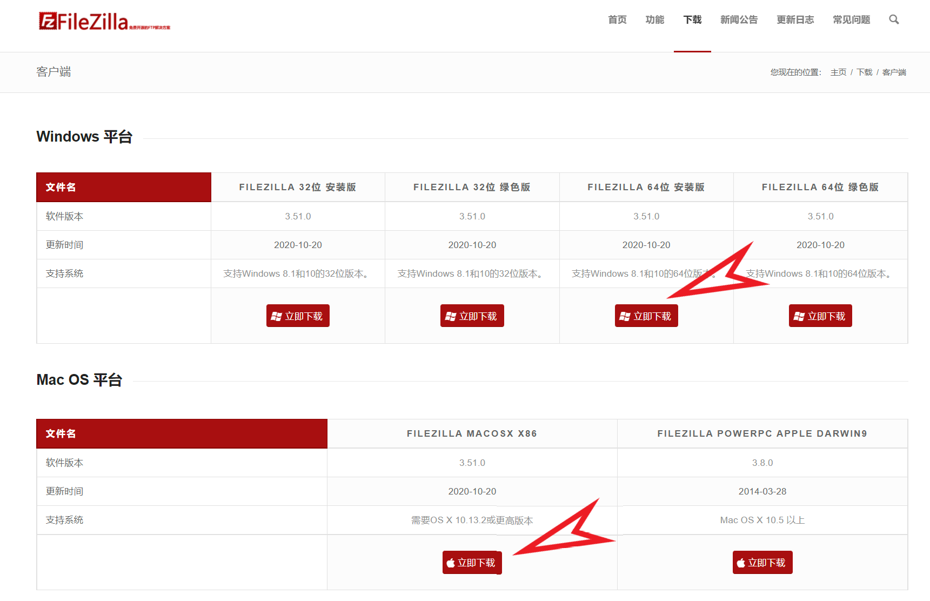
Install FileZilla
https://www.filezilla.cn/download/client

